Slide 1

Title: Exploring Student Success: An EDA and Machine Learning Approach

Slide 2

Introduction: In this presentation, we will delve into a dataset containing information on students enrolled in a higher education institution. Our goal is to analyze and understand the factors influencing student enrollment, academic performance, and socio-economic background. Through Exploratory Data Analysis (EDA) and Machine Learning techniques, we aim to identify patterns, trends, and potential areas for improvement in the educational system.

Slide 3
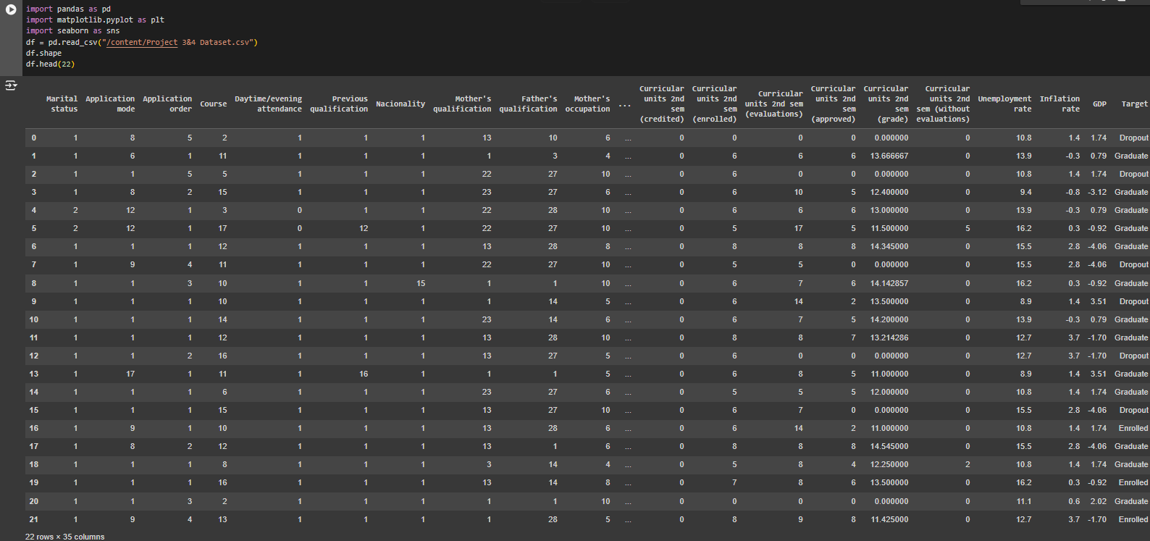
Data Sample: 22 rows x 35 columns

Slide 4
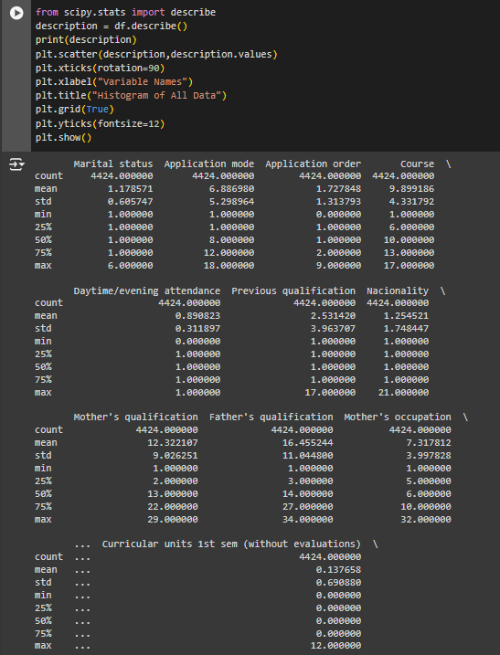
Data Description:
Calculated Count, Mean, Standard Deviation, MinMax of each of our Data’s features for better understanding and visualization

Slide 5
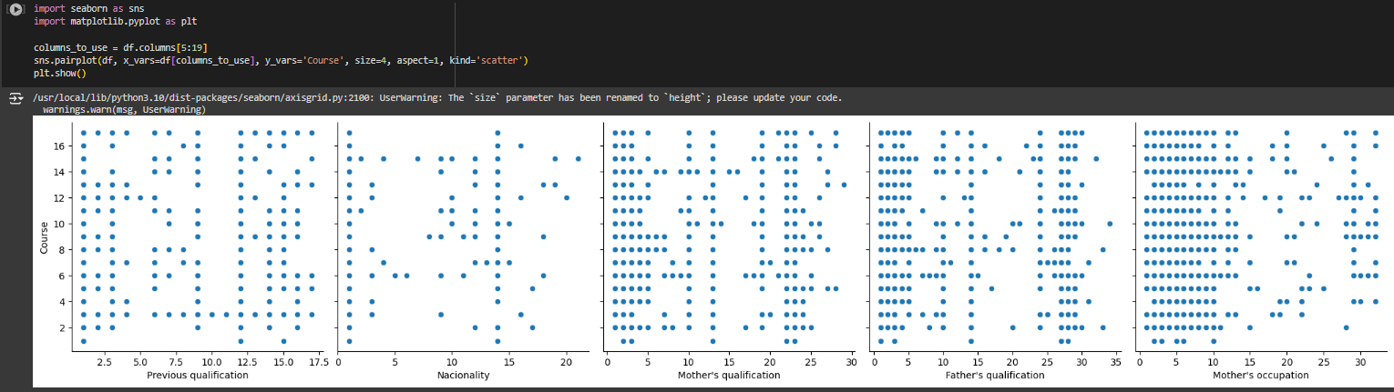
Scatter Visualization of unBinary Features with respect to Course

Slide 6
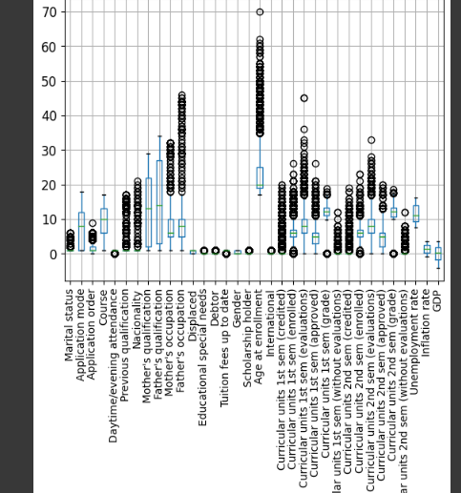
Identification of Outliers: it readily reveal outliers that might require further investigation and dealing with
Box Plot

Slide 7
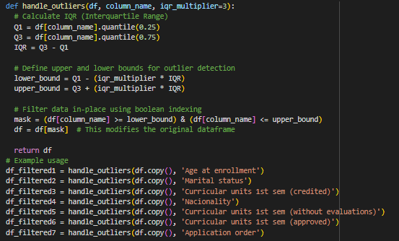
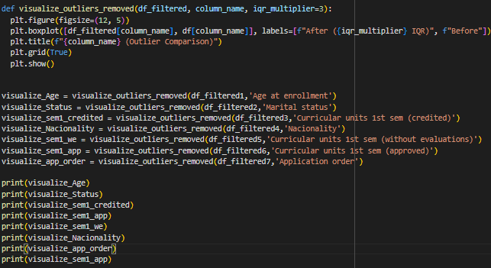
Handling Outliers
The Interquartile Range, or IQR, tells you how spread out the middle half of your data is. Imagine dividing your data, ordered from least to greatest, into four equal quarters. IQR focuses on the two middle quarters, discarding the potential influence of extreme values at the very beginning or end. By calculating the difference between the upper middle quartile (Q3) and the lower middle quartile (Q1), IQR provides a measure of variability within the central portion of your data set. This makes it a valuable tool, especially when dealing with skewed data or data containing outliers, as it's less sensitive to these extremes compared to the overall range.

Slide 8
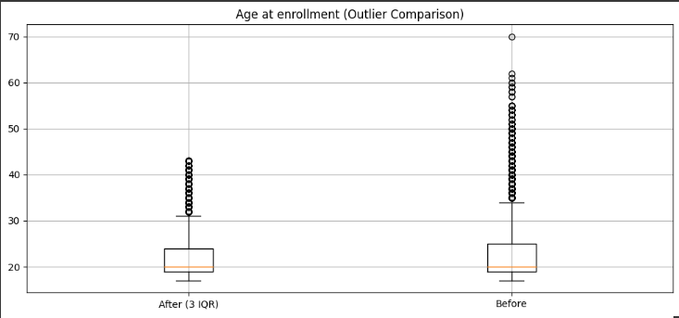
Results of some IQR :
Page: 1

Slide 9
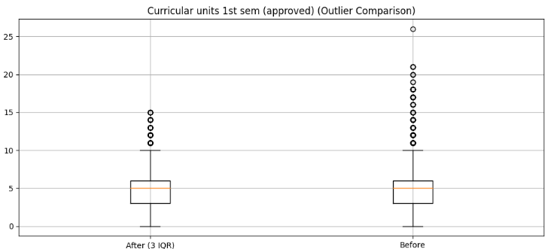
Results of some IQR :
Page: 2

Slide 10
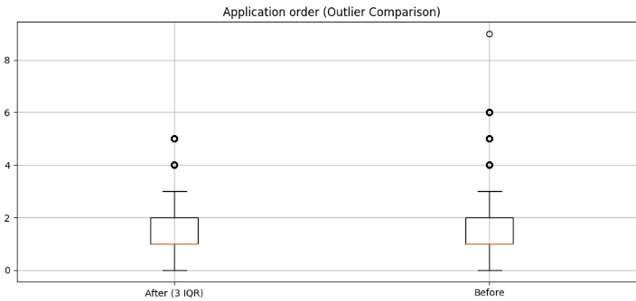
Results of some IQR :
Page: 3

Slide 11
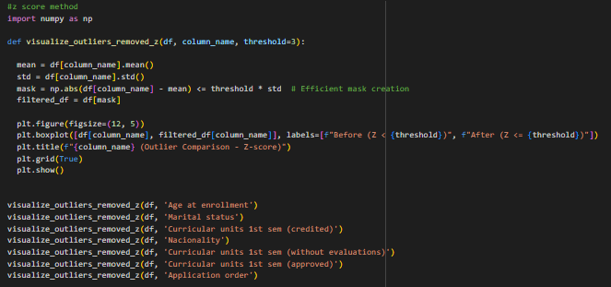
Applying Z-Score Method

Slide 12
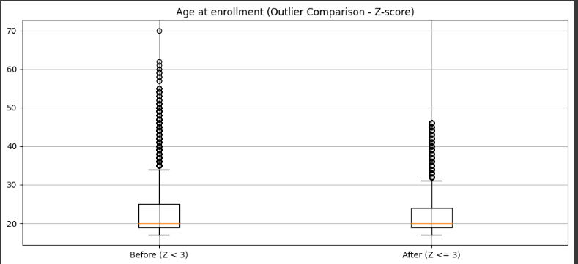
Results of Z-Score:
Page: 1

Slide 13
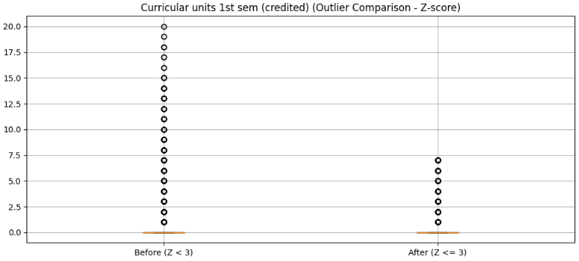
Results of Z-Score:
Page: 2

Slide 14
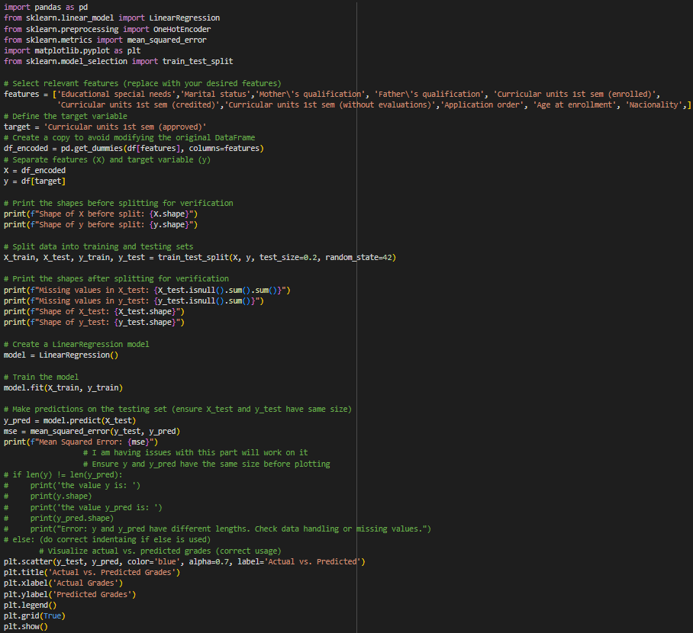
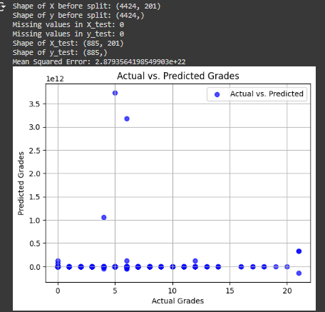
Machine Learning

